Slide 1
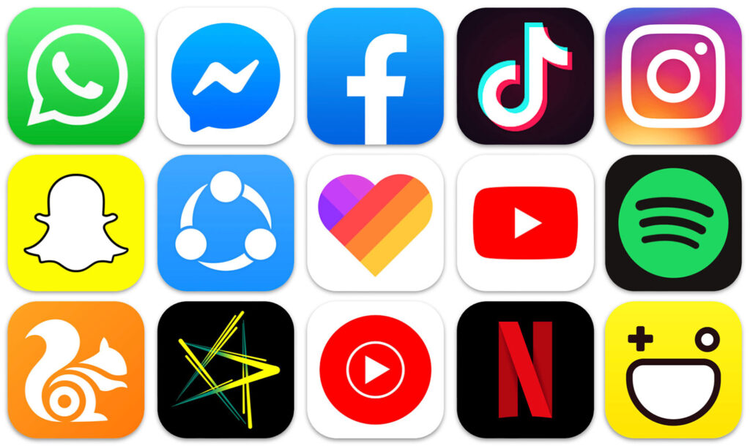
Application…?

Slide 2
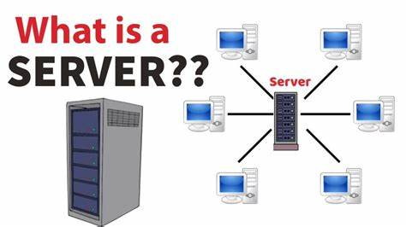

Slide 3
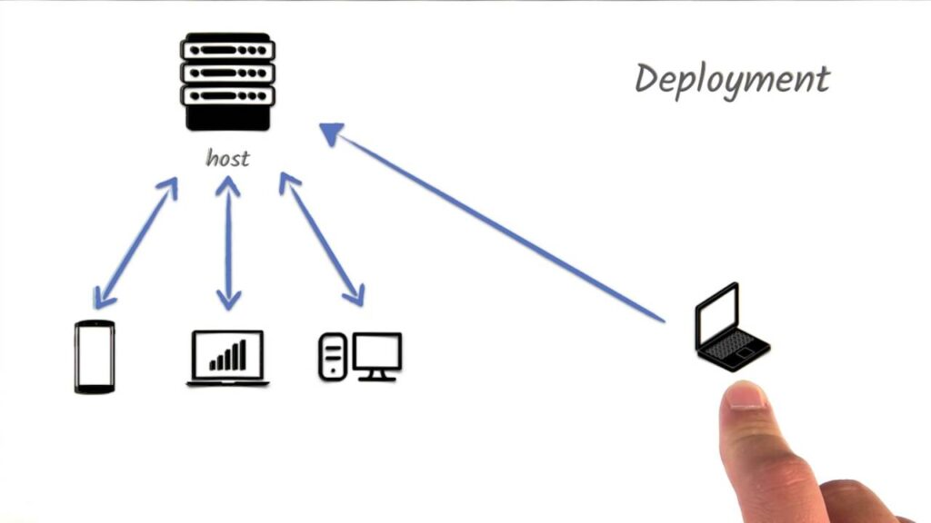

Slide 4
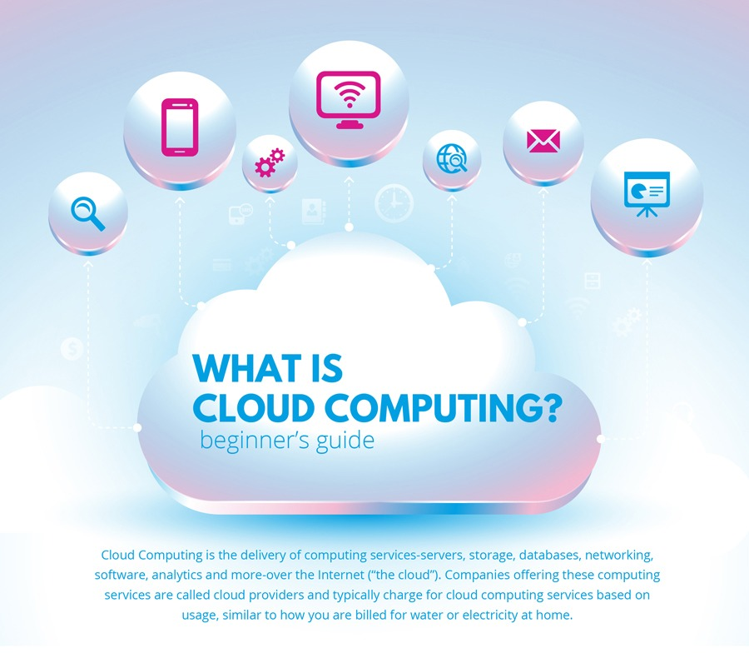

Slide 5
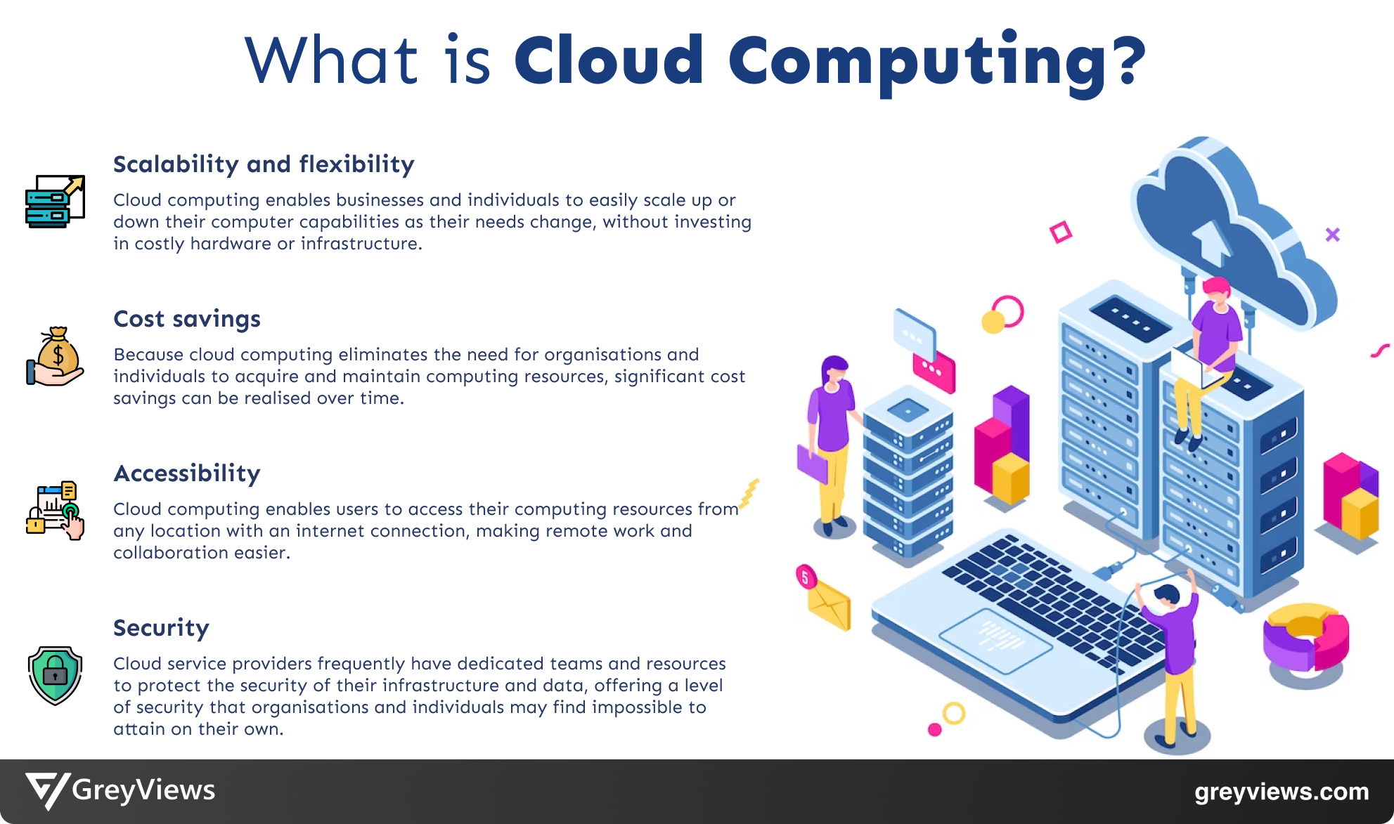

Slide 6
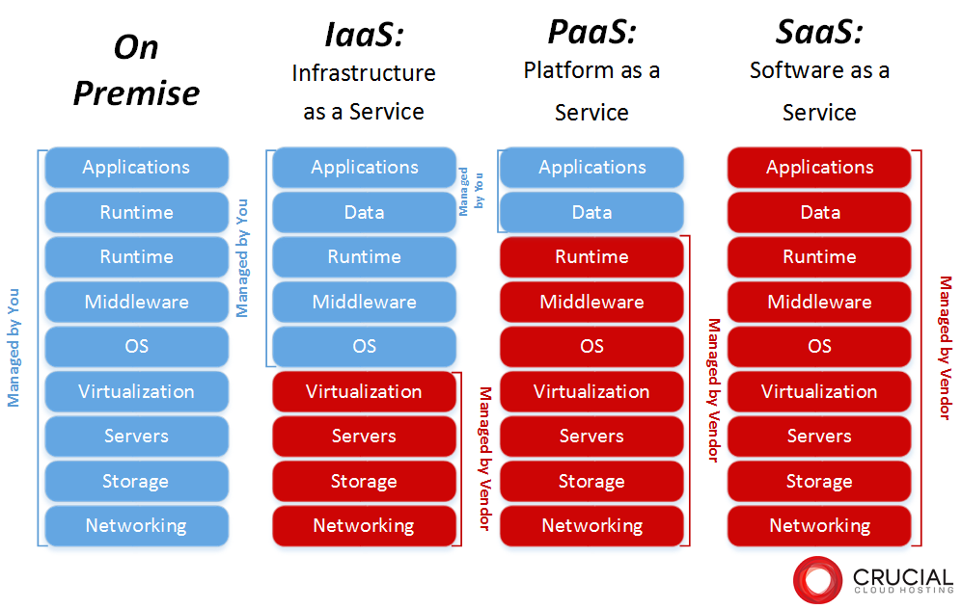

Slide 7
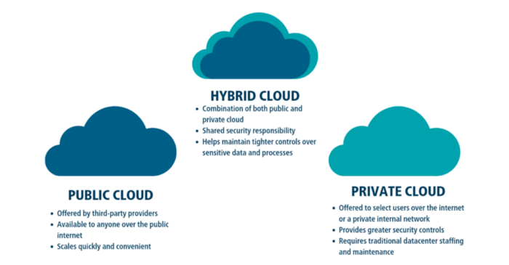

Slide 8
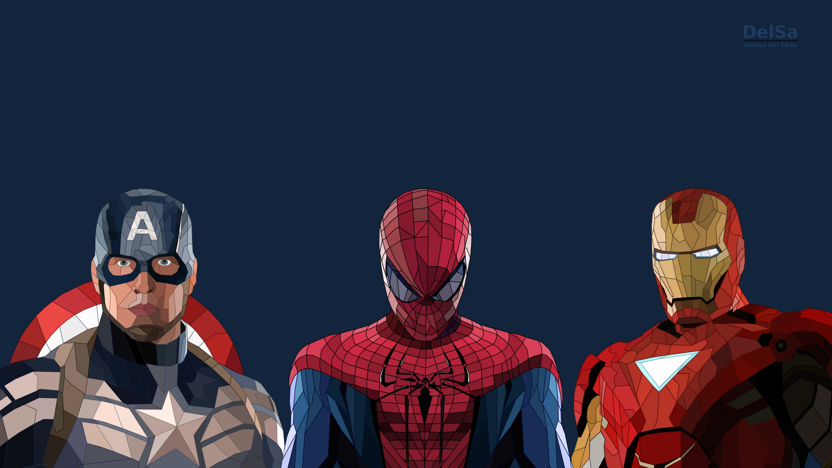
Hybrid Public Private

Slide 9
WHAT IS CLOUD PROVIDER….?

Slide 10
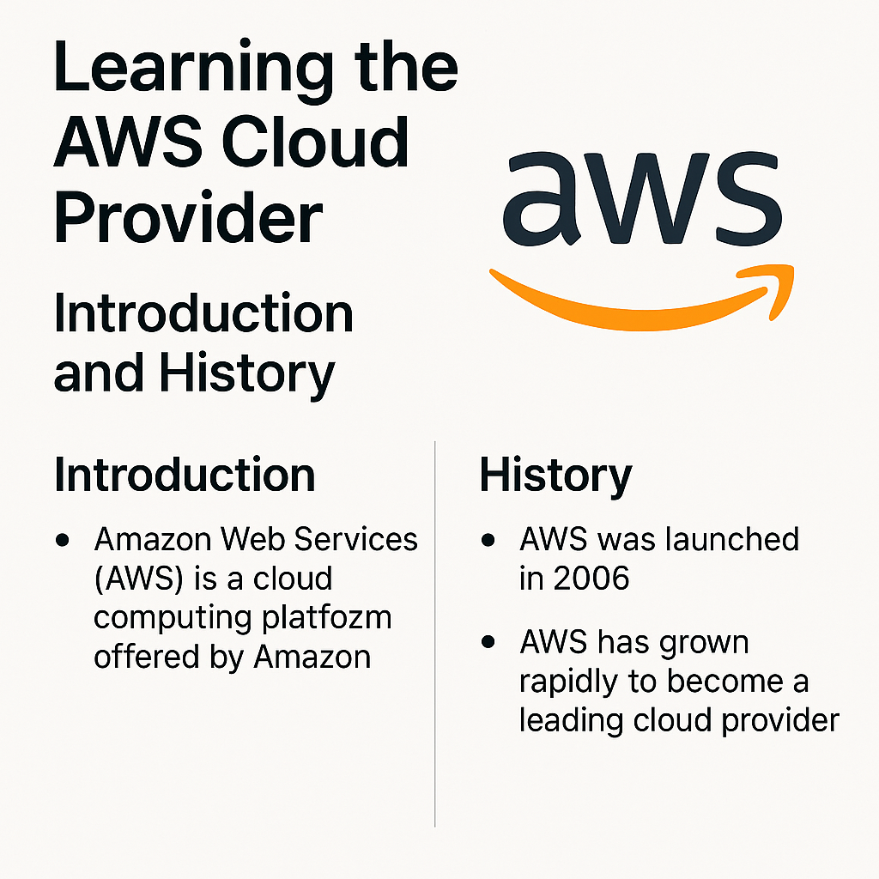

Slide 11
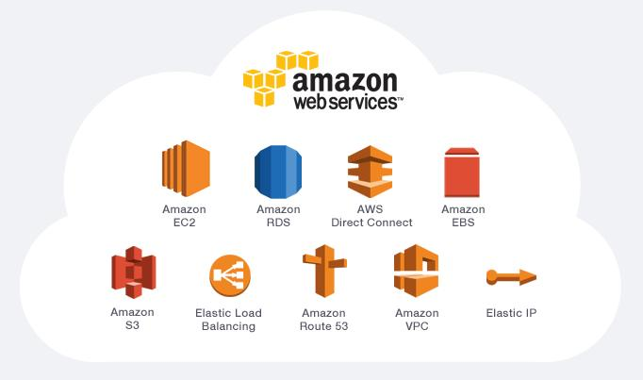

Slide 12
AWS SERVICES —
Elastic Compute Cloud
S3
Identify and Access Management
Command Line Interface
Relational Database Service
Cross Region Replication
Elastic Load Balancer
Elastic Block Storage
Virtual Private Cloud
Route53
AWS Backups
CloudTrail
Elastic Container Refistry
Elastic Container Service
Elastic Kubernetes Service
Elastic Bean Stalk
Cloud Formation Template
Cloud watch
Auto Scaling Groups
Lambda
Code Pipeline
Cloud Front

Slide 13
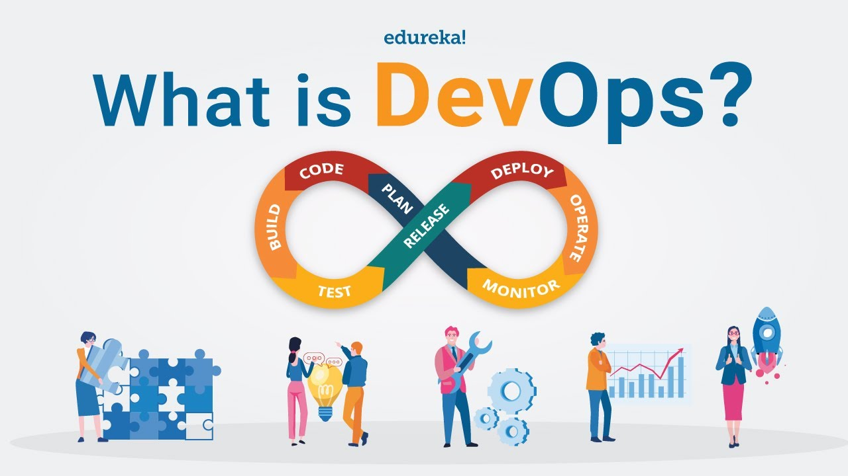


Slide 14
What is DevOPS :
DevOps is a combination of the terms Development and Operations. It represents a set of practices that aim to bridge the gap between software development (Dev) and IT operations (Ops).

Slide 15
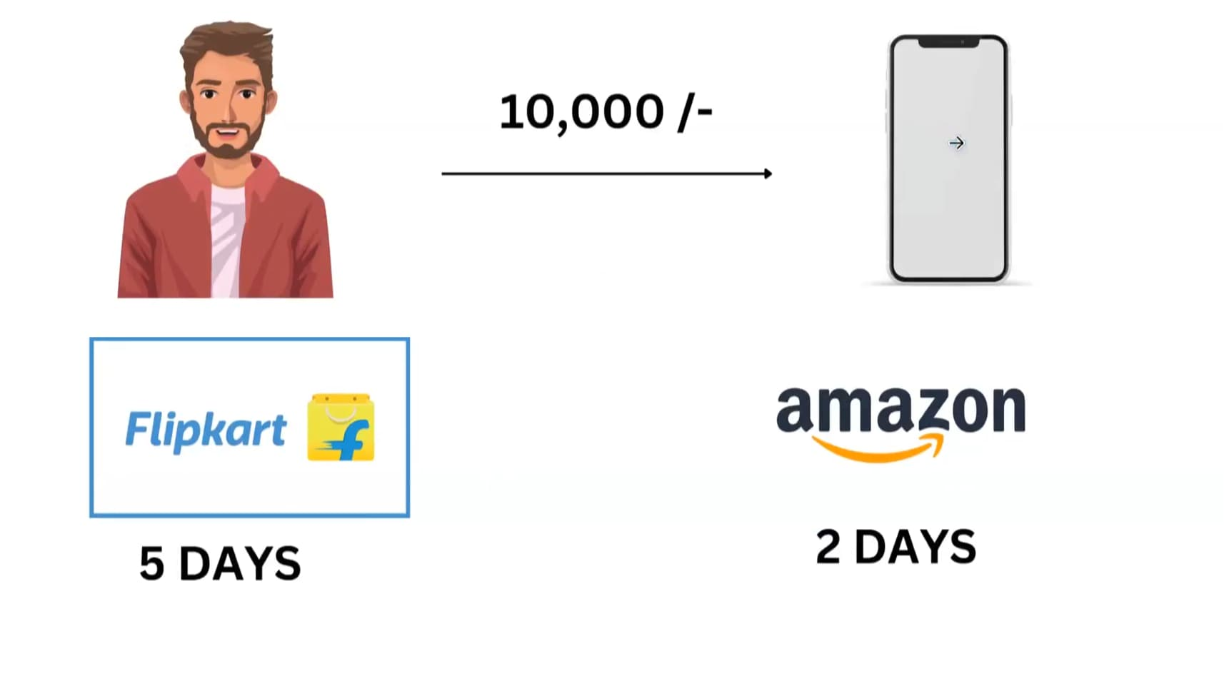

Slide 16
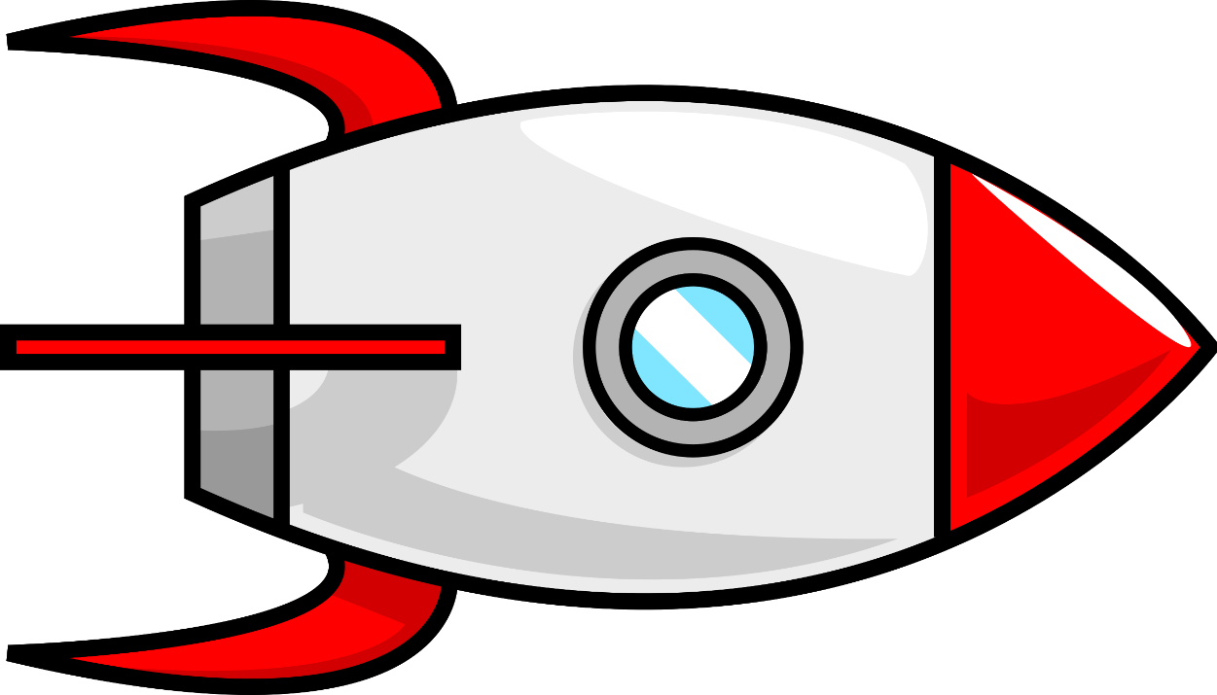
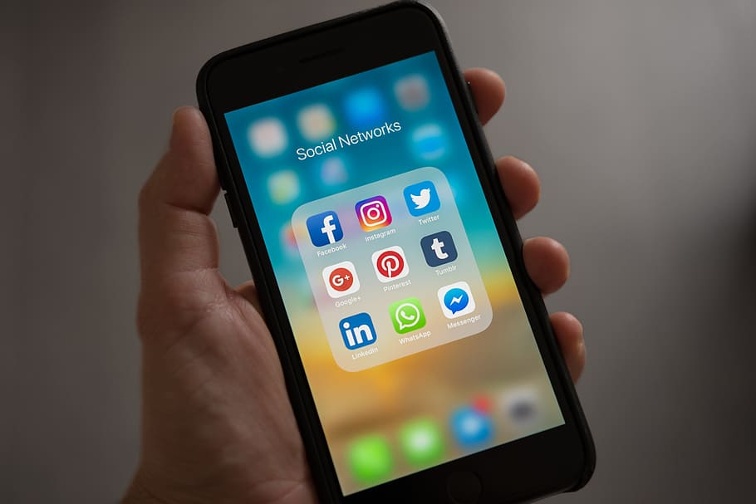
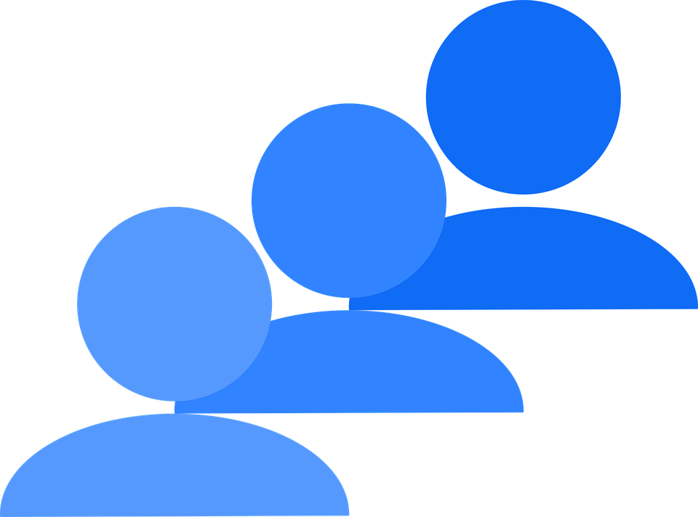
Why DevOPS :
The purpose deliver the application very speedily to the Users.
Applications
Users

Slide 17

BUT HOW THIS WILL HAPPEN ?
?

Slide 18
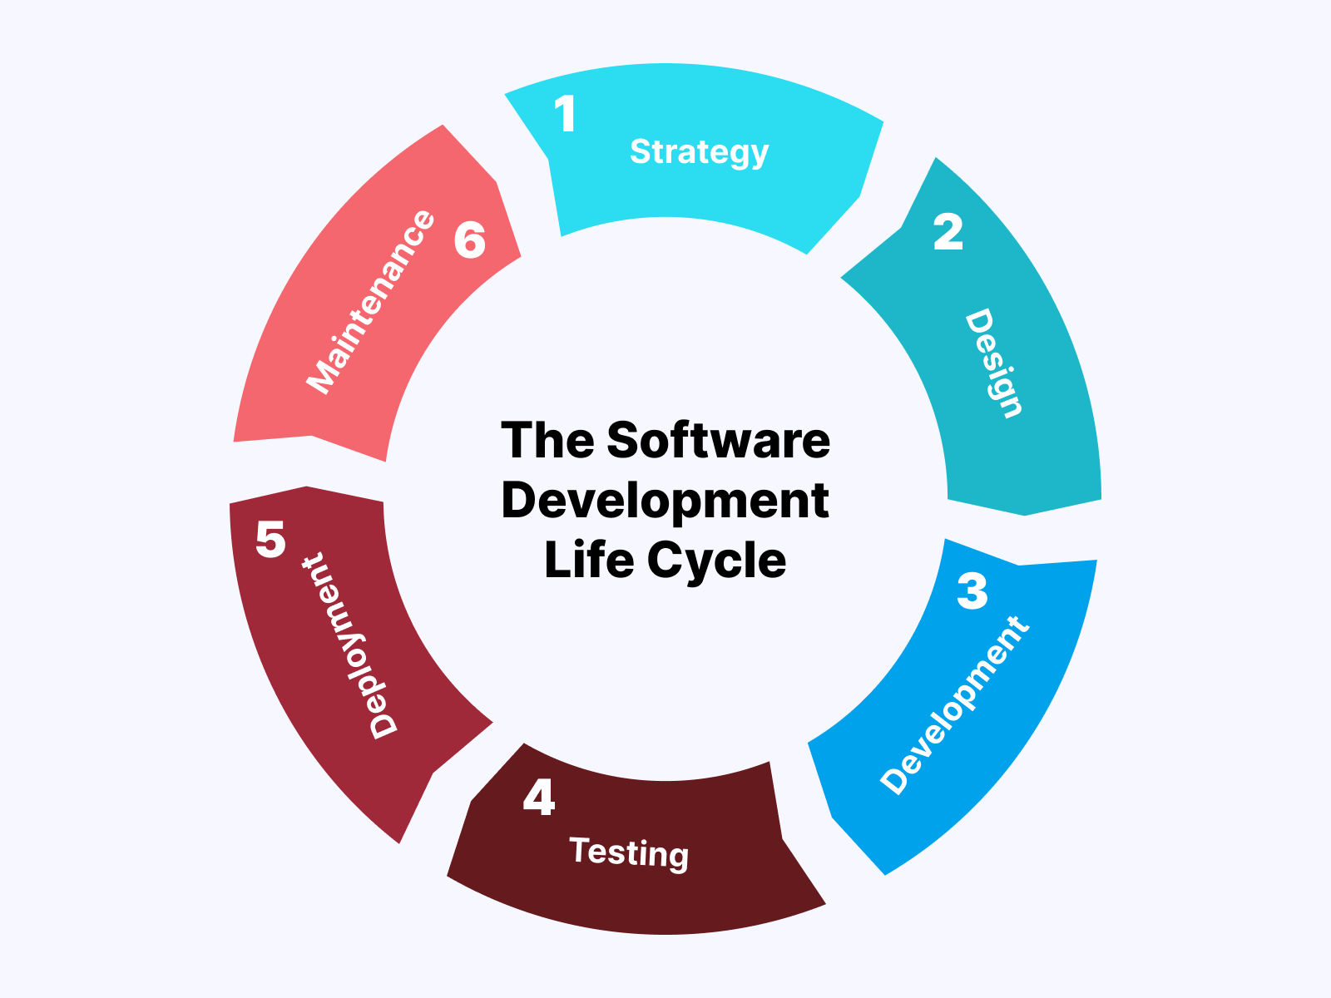
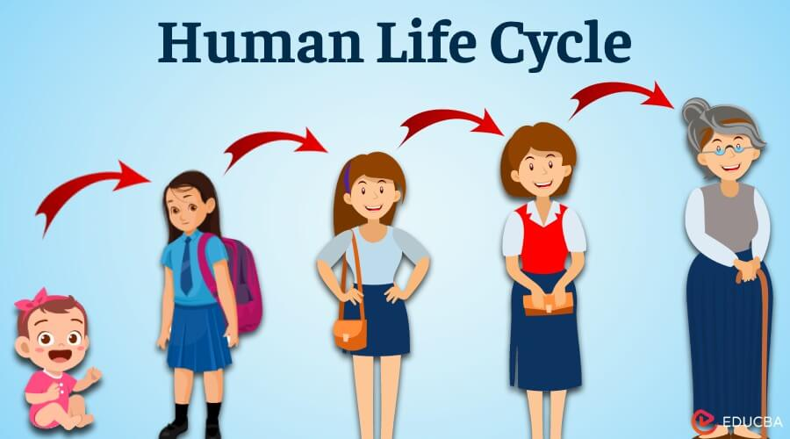

Slide 19

STRATEGY or PLAN
Requirements gathering from the client.
Technology Stack.
Budgeting.
Architectures.

Slide 20
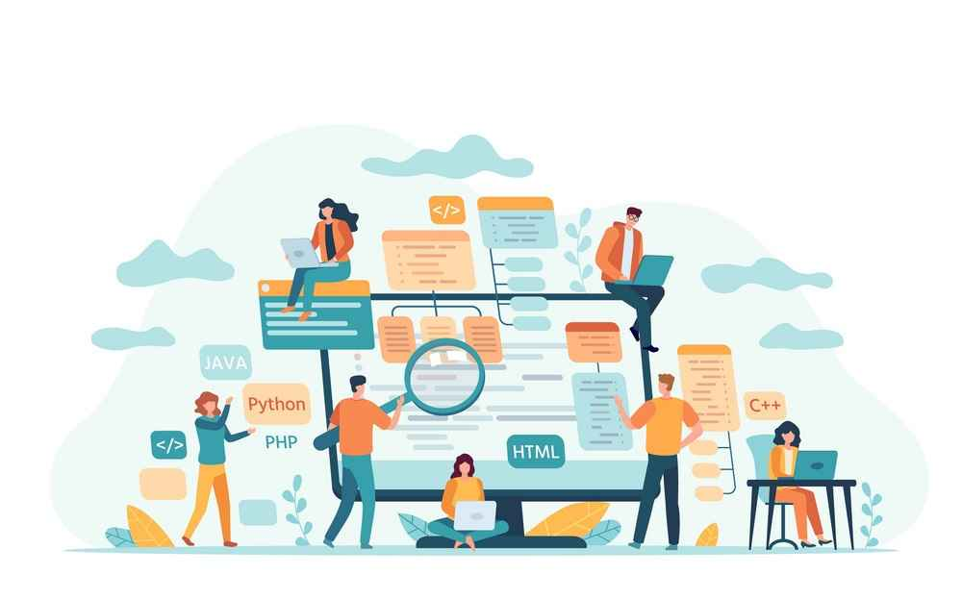
DESIGN or CODE
There are numerous catefories of technologies involved in application development like HTML,CSS,JS,REACT .NET and many more like others.

Slide 21
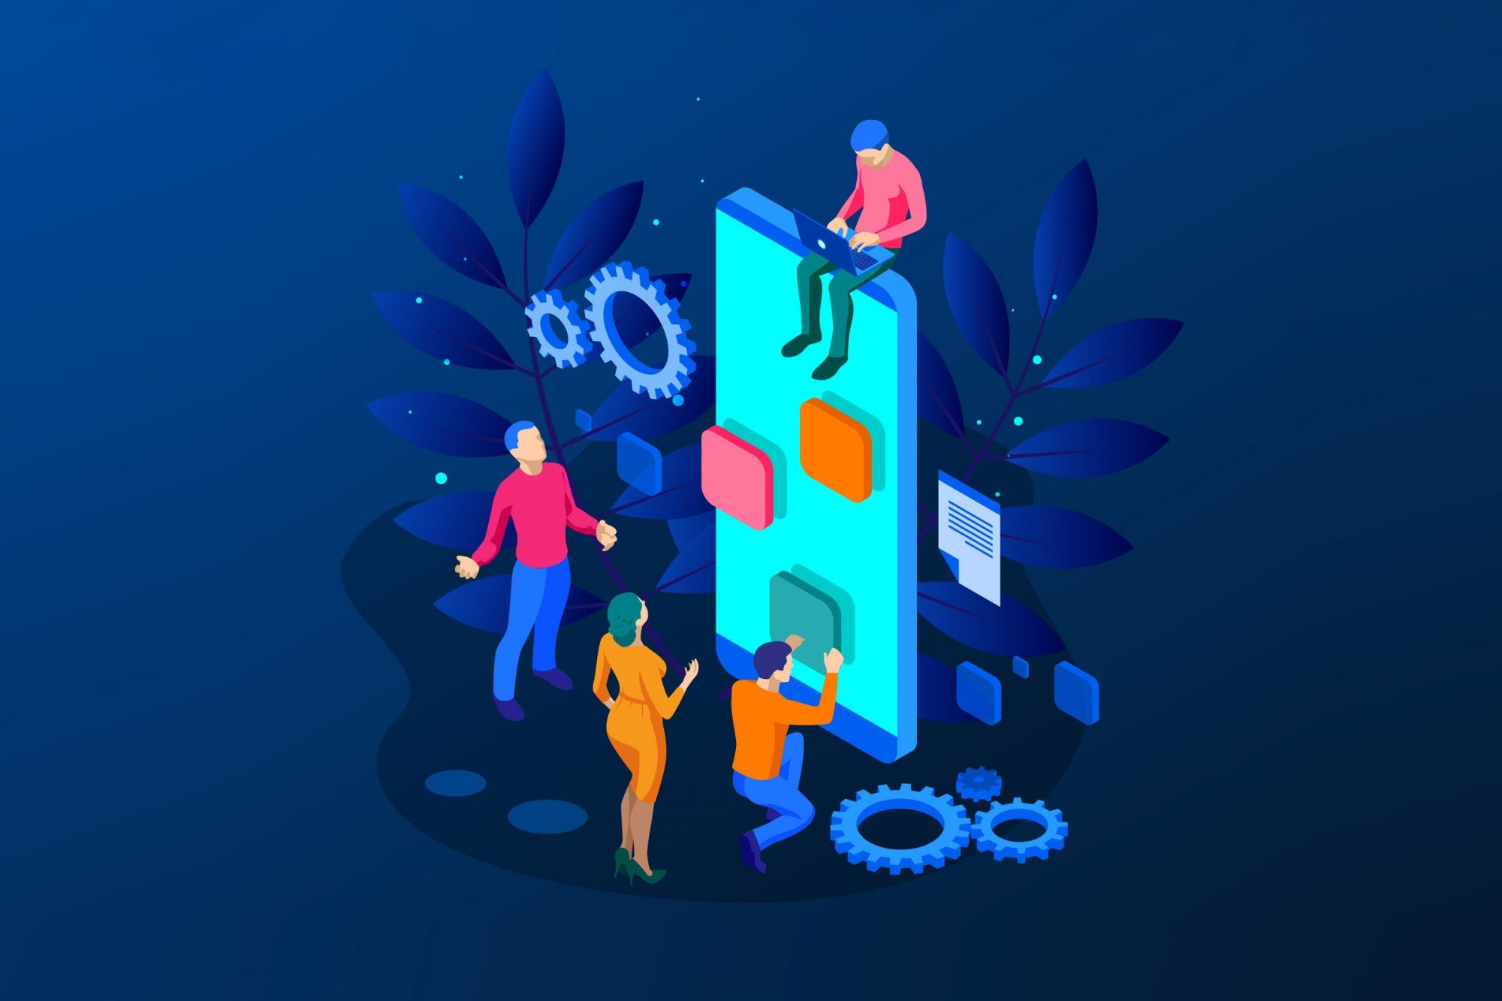
BUILD OR DEVELOPMENT
Combining all the codes. Or Paking the application.

Slide 22
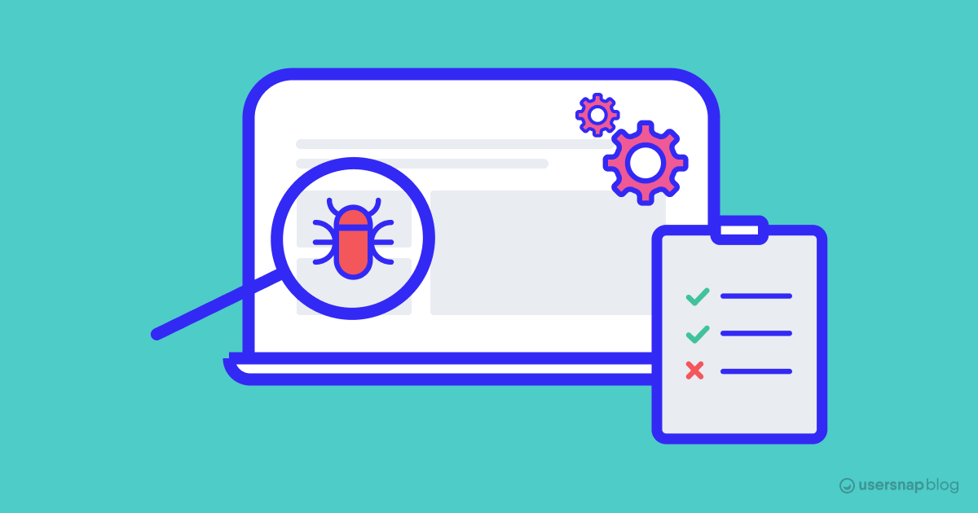
TESTING
Bugs.
Performance.
Does it meets the client requirements.
Sercurity.

Slide 23
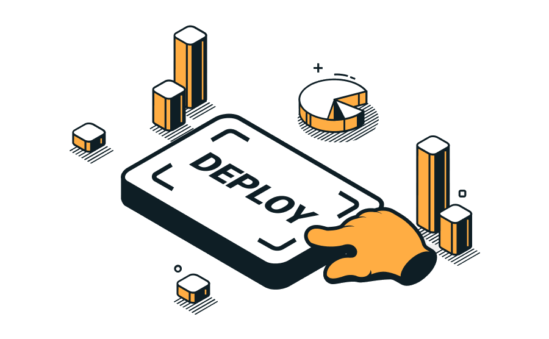
DEPLOY
Deployment is the processes of the installing the application from local laptop to server.

Slide 24
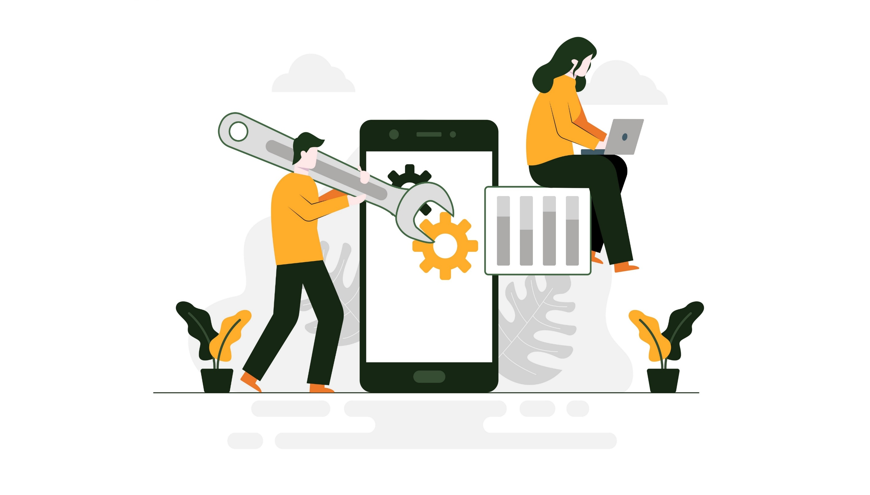
MAINTENANCE

Slide 25
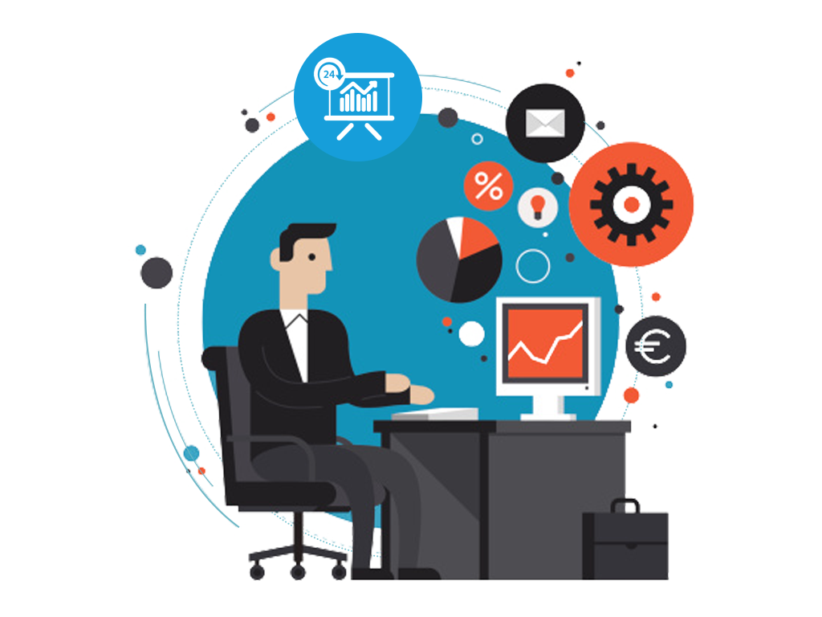
MONITOR

Slide 26
BUT HOW APPS WILL BE CREATED ?
?

Slide 27


Slide 28
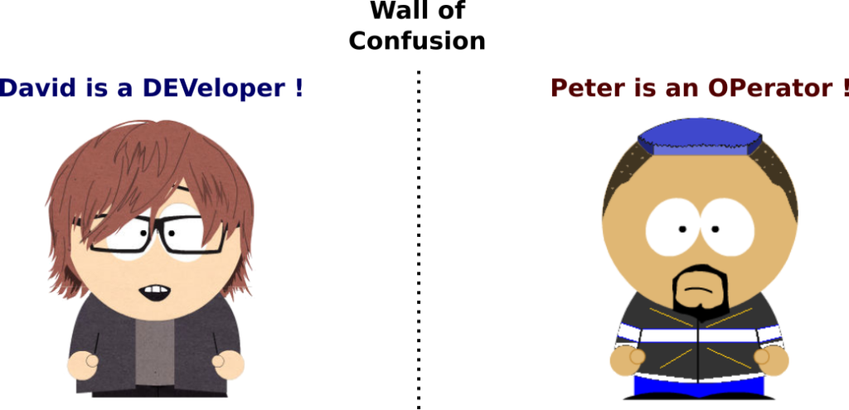

Slide 29

DEVOPS LIFE CYCLE :
The Logo of DevOps represents infinite because its a never ending continuous process.

Slide 30

DEVOPS BOY
HE CAN DO IT

Slide 31
BEFOR DEVOPS???
WATERFALL METHODOLOGY
The Waterfall methodology – also known as the Waterfall model or classic model.
It will follow steps by steps execution.
We can work on one step at a time.

Slide 32
Technical Skills –
Version control : Git
Continuous Integration : Jenkis
Build Tool : Maven
Containerization : Docker
Container Orachestration : Kubernetes K8S
Deployment : Argocd
Monitoring : Prometheus & Grafana
Artifactory : Nexus
IAAC : Terraform, OpenTofu
Platform : Linux and Windows
Web App Server : Apache Tomcat/ Nginx
Other tools : Terraformer
Cloud Environment : AWS

Slide 33
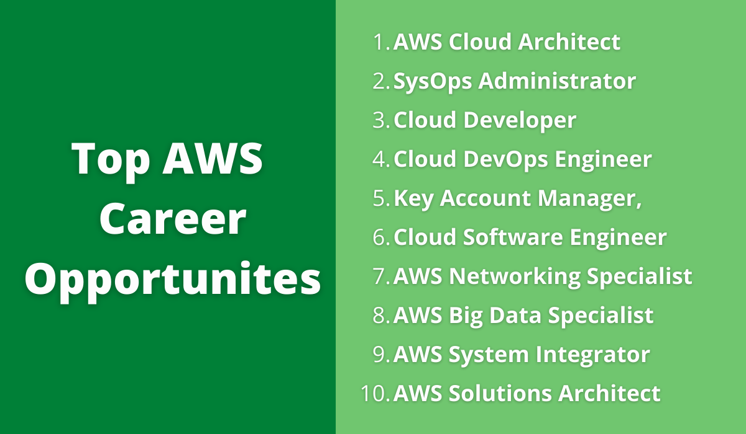

Slide 34

TNX ALL
THIS IS THE END OF SESSION

